Slide 1
XIMO 2.0
Xenodochial Manipulative Intelligent Operator

Slide 2

Table of Contents
1
3
2
4
Introduction
Electronics Aspects
A brief info about XIMO2.0
It covers elctrical parts of the bot
Mechanical Aspects
Future Scope
It covers CAD-design and other stuff
It includes upcoming development of bot

Slide 3
1
Introduction

Slide 4
Purpose and Objective
XIMO 2.0 is a low-cost, wireless-controlled, modular robotic arm built for education,
prototyping, and lightweight industrial use.
It’s controlled via a web-based interface hosted by an ESP32 microcontroller.
So we focused on three key areas:
1. Wireless real-time control using ESP32
2. Modular mechanical and electronic design
3. An interactive, web-based control system

Slide 5
MechanicalStuff

Slide 6
Mechnical Asspects
CAD Design
3D Printing
Desgined arm in solidworks
Printed the parts on creality ender
Kinematics Analysis
Assembly
Assembled the parts.
Applied Inverse kinematics and gait pattern

Slide 7
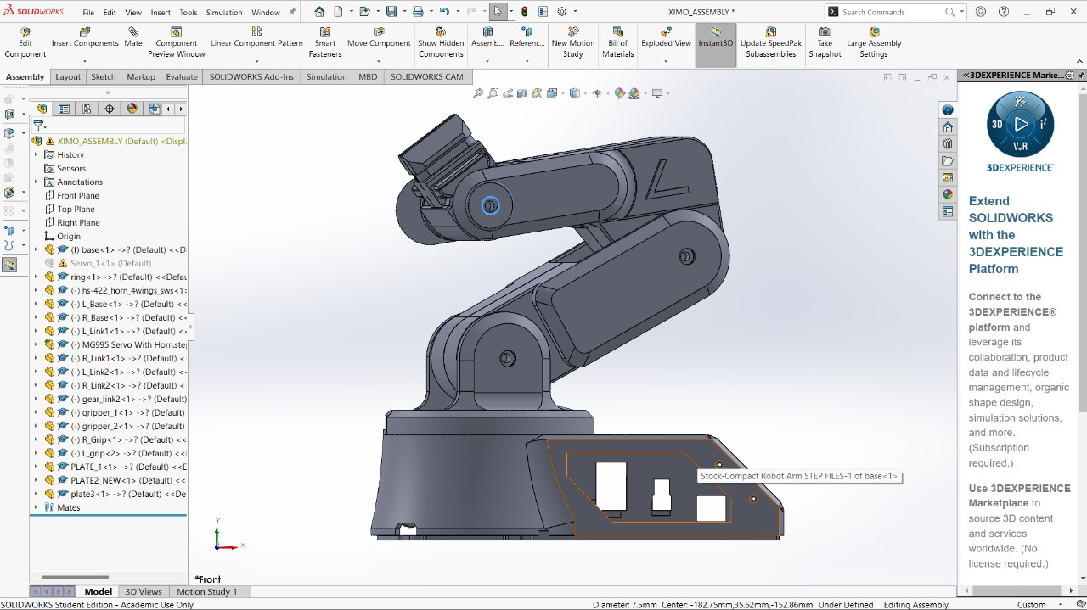
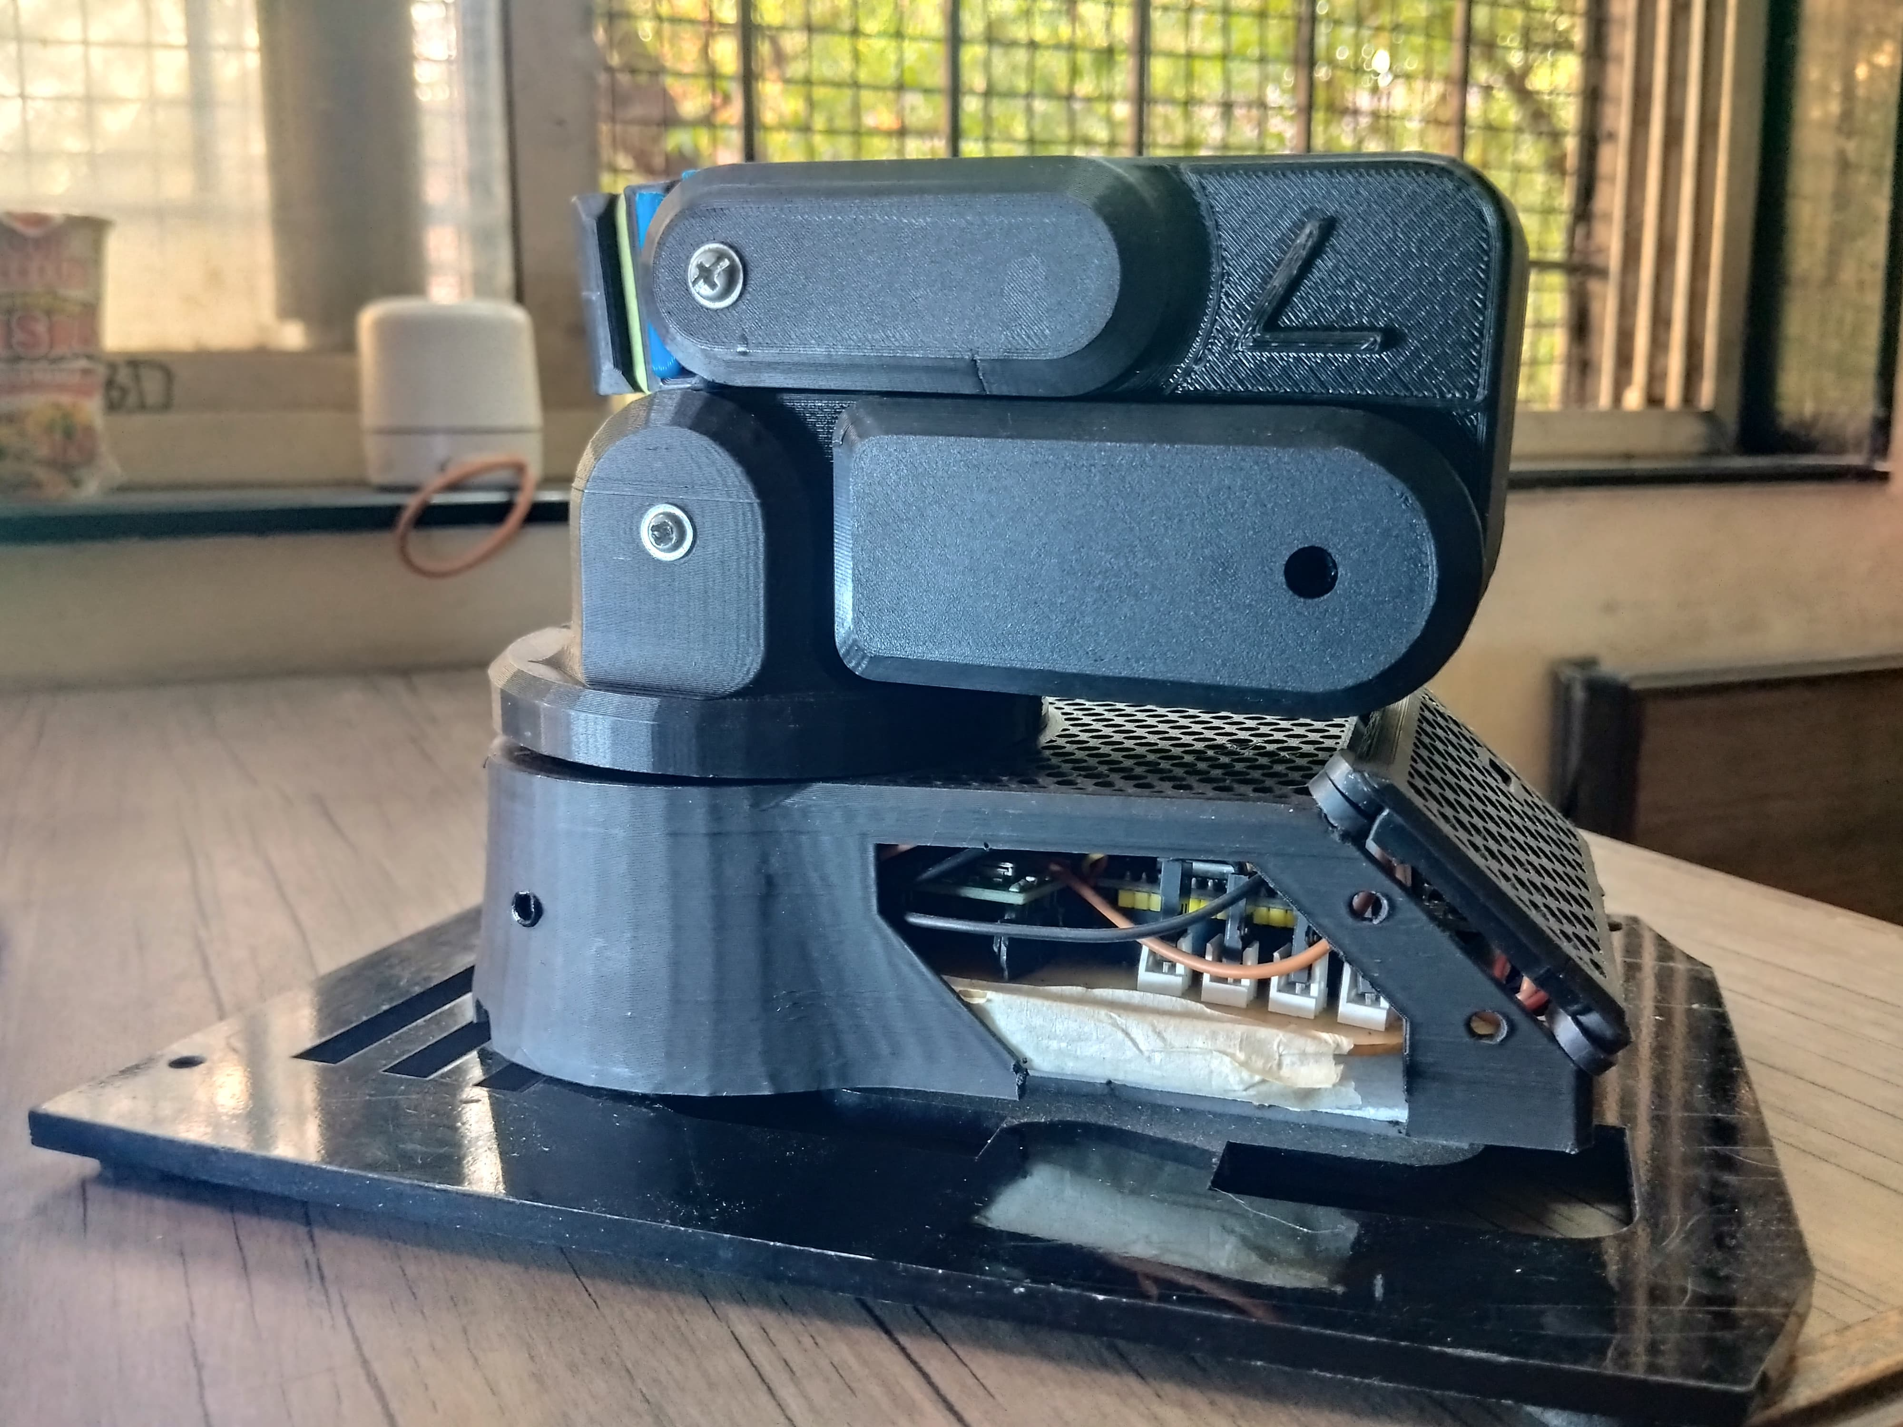
Images

Slide 8
Elctronics Stuff

Slide 9
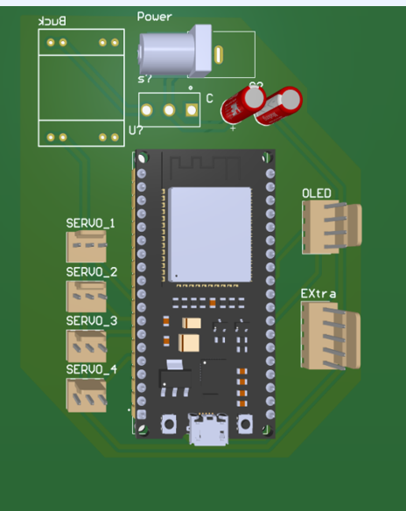
Anatomy Of The Error
Hardware
5 servo motors, esp32, buck etc
Custom PCB
Used Altium software for PCB
Power Mangment
Used an AC power supply

Slide 10
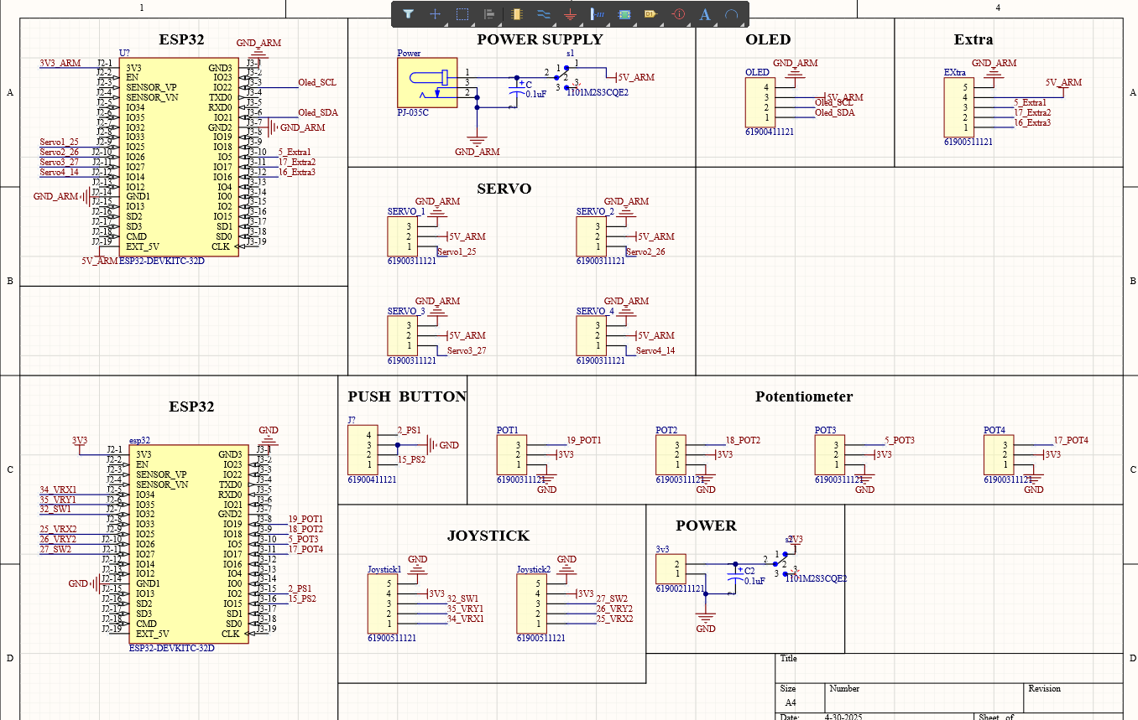
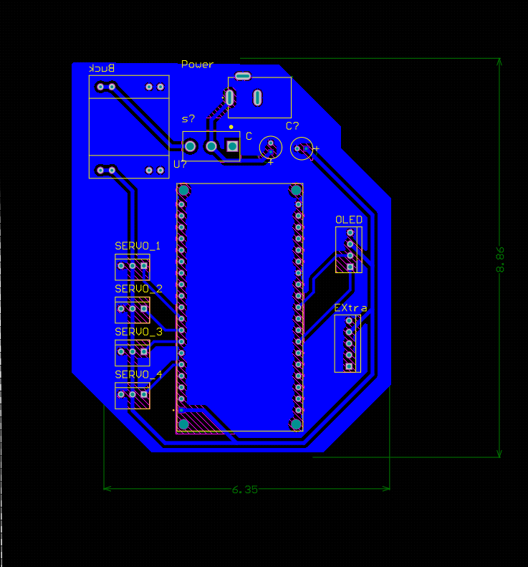
Schematic

Slide 11
Web-Server
We designed a custom webserver on ESP32 to wirelessly control the arm.
This makes it very intuitive for first-time users.

Slide 12
Future Scope
35%
Simulation of arm
65%
Training AI models
85%
Using ROS for automation
50%
Image or Vision
Processing

Slide 13
Testing Videos

Slide 14
THANKS!
Presented by :- Laya Kshetrapal Sneha Raut

